Slide 1
Housekeeping
Packages should be installed prior to the workshop.
If you don’t have the packages installed, you might not be able to run the code. But don’t worry, just download the solution.html and view the document and follow the workshop content!
For each module, I’ll explain the concepts first and then leave time for you to run the code. You might need to fill in some code youselves.
Might spend some time on explaining the data structure, please be patient! The exciting analysis modules come soon after that!

Slide 2
SPIAT spaSim workshop
8 Nov 2023
Peter MacCallum Cancer Centre

Slide 3
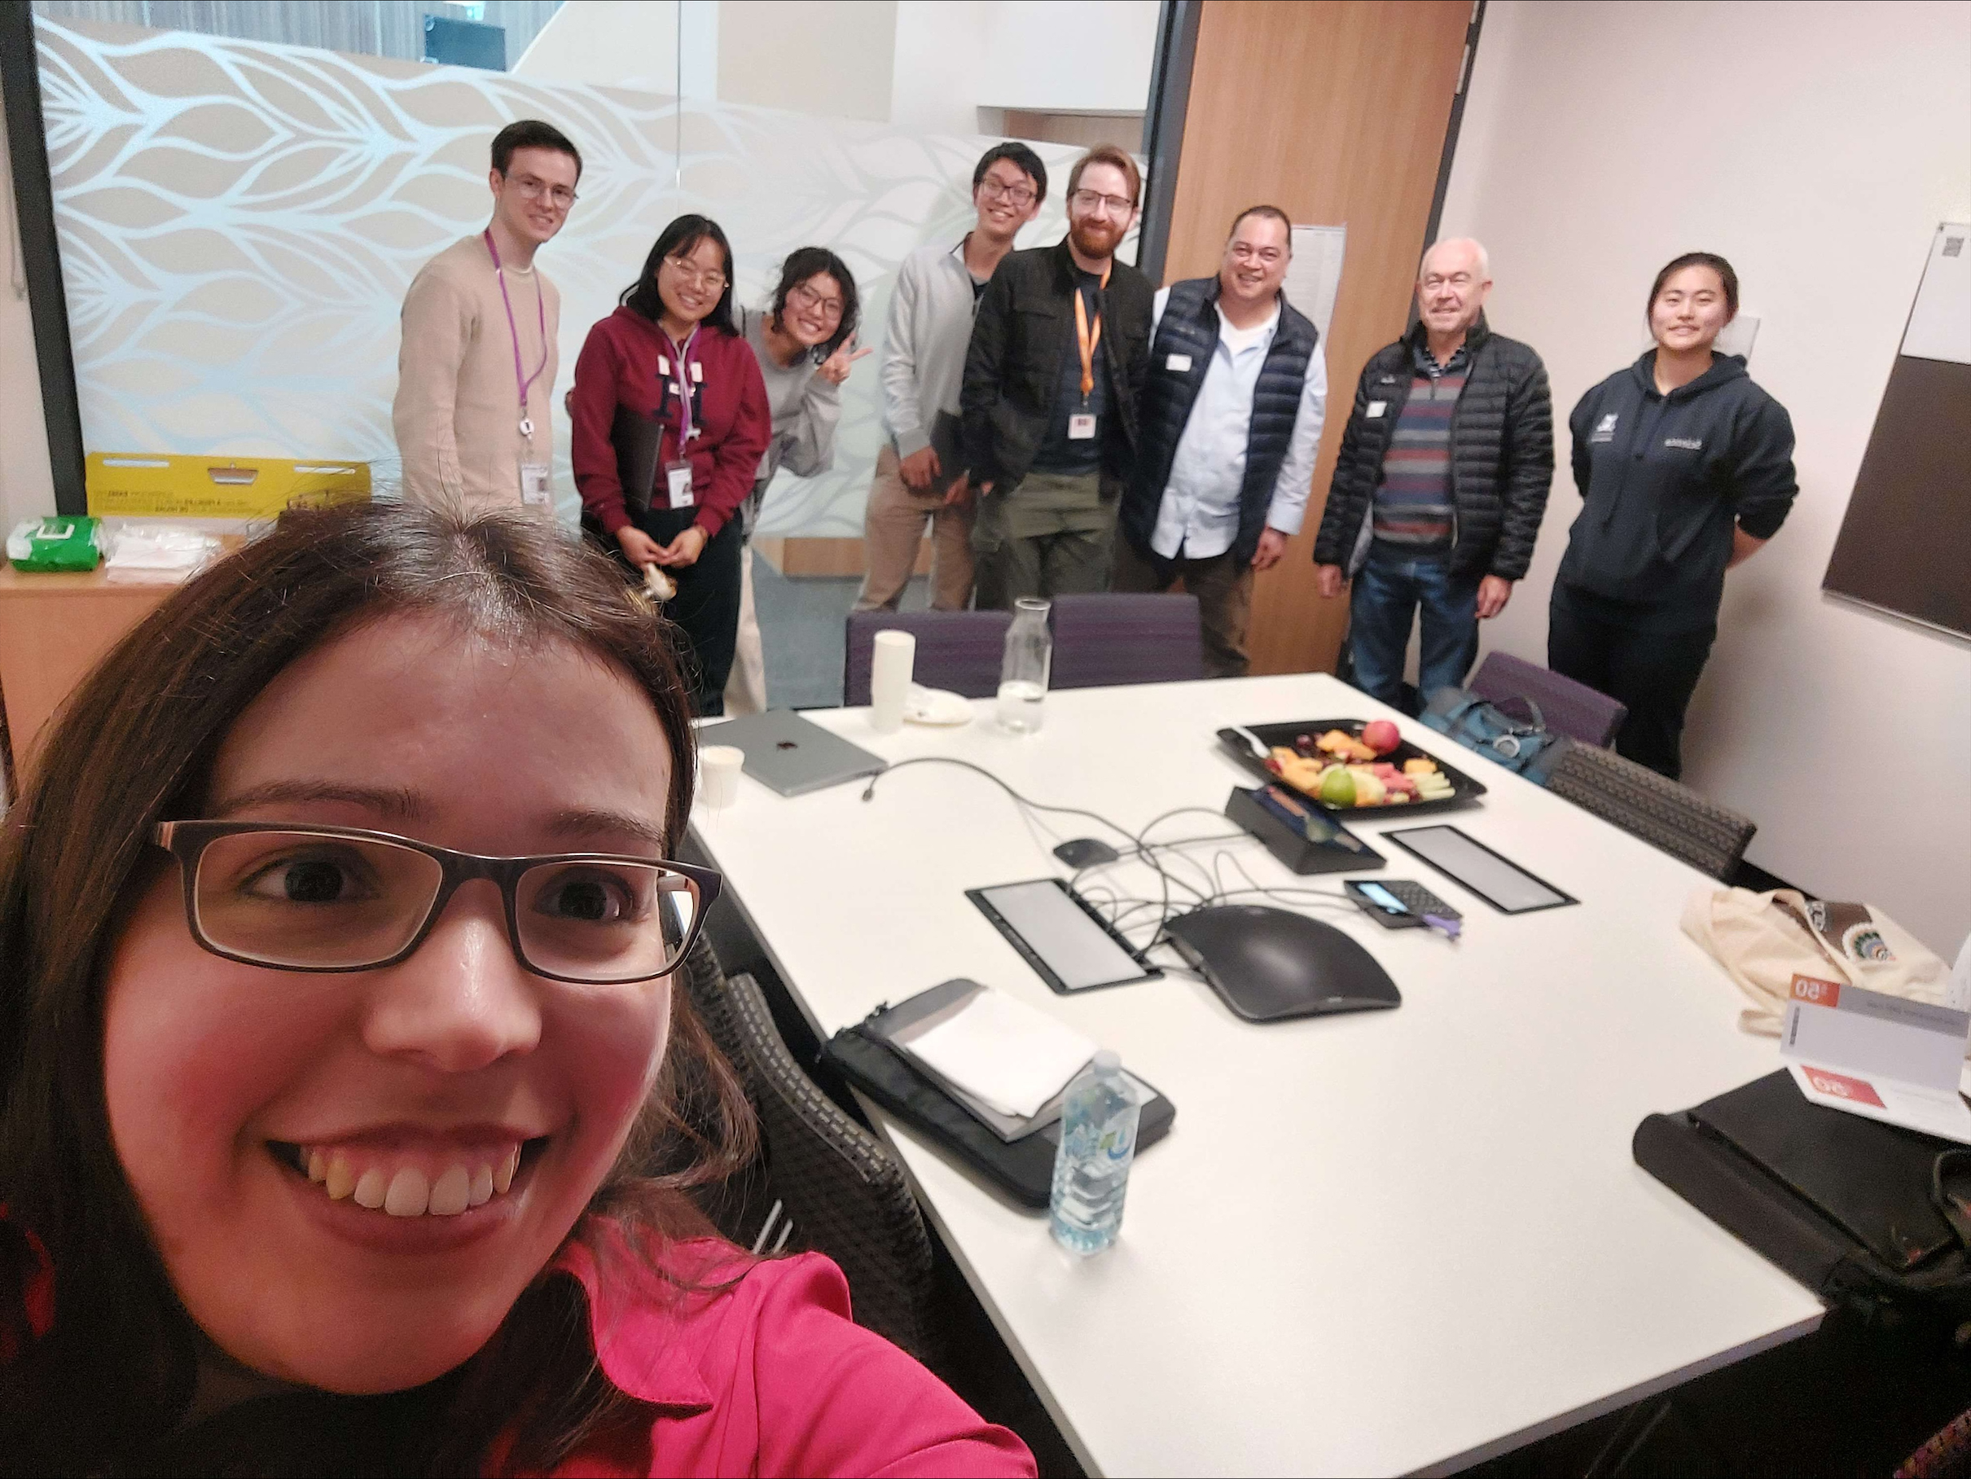
Trigos Lab at Peter MacCallum Cancer Centre
Lab members:
Lachlan Cain (RA)
Sirui Weng (PhD student)
Yangyi Zhang (Masters student)
James Comben (Honours student)
David Le (Summer student)
Alumni (SPIAT):
Tianpei Yang
John Zhu
Mabel Li
Volkan Ozcoban
Lab head: Dr Anna S. Trigos
Multi-omic Evolution and Ecosystems
Computational Biology Program
Consumers:
Graeme Sissing
Steve Cavill

Slide 4

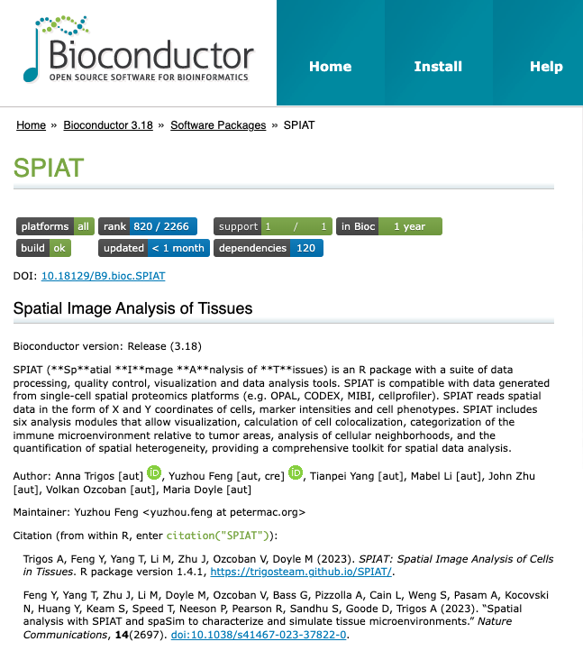
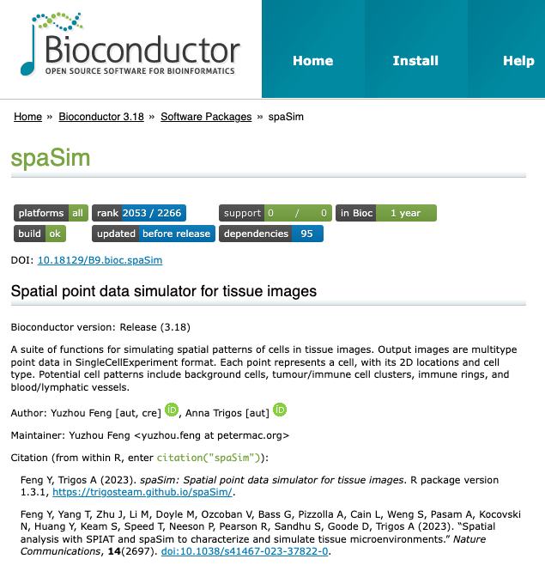
Acknowledgement

Slide 5
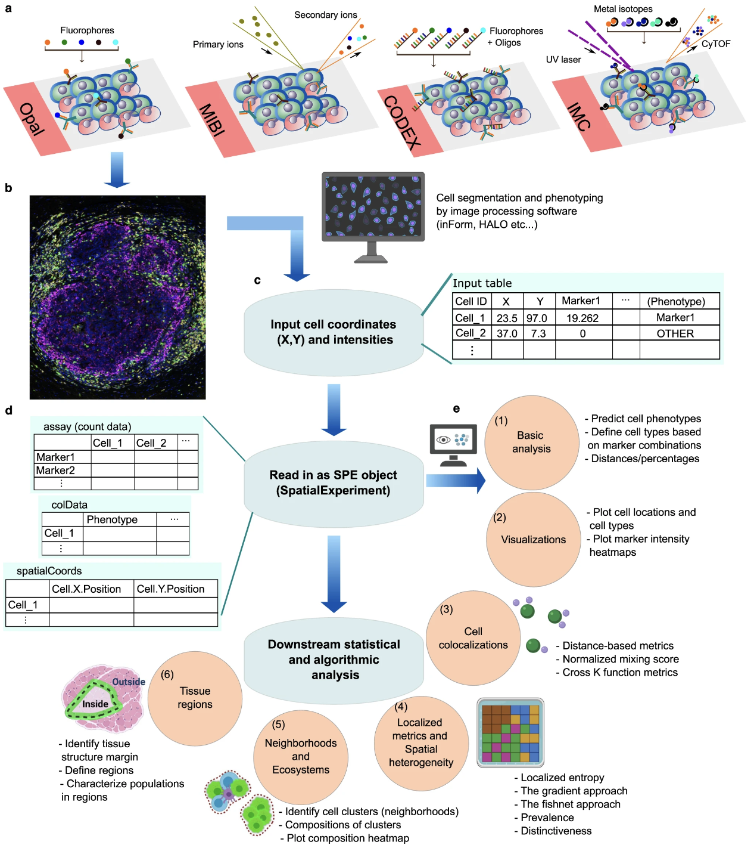
SPIAT – Spatial Analysis of Tissues

Slide 6
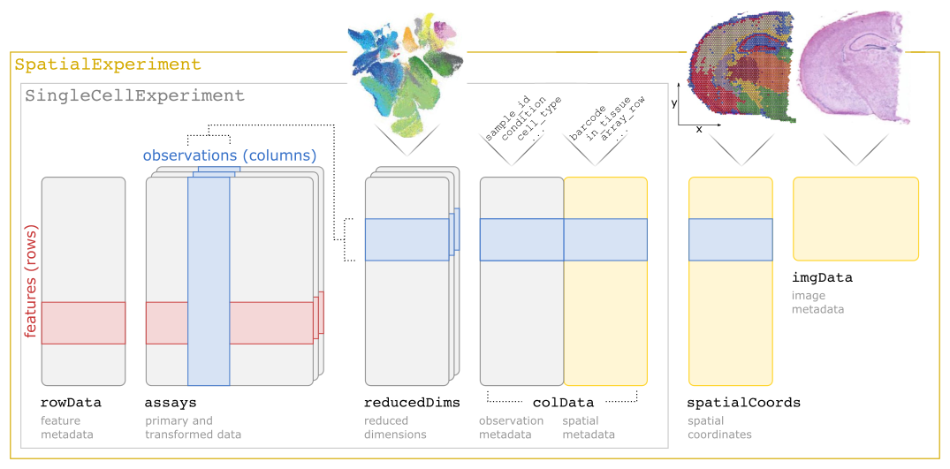
SpatialExperiment (SPE)
https://github.com/drighelli/SpatialExperiment
Notes:
SpatialExperiment is an R object for storing data from spatial -omics experiments.
You can see this as a structure to store the essential components of your data
The following schematic illustrates the SpatialExperiment class structure.
The class extends the SingleCellExperiment class for single-cell data to support storage and retrieval of additional information from spot-based and molecule-based platforms,
including spatial coordinates, images, and image metadata.
This is the core object of SPIAT. As most of the functions operate on this objct. So let’s see what it is like.

Slide 7
TNBC MIBI data
41 female patients with triple-negative breast cancer (TNBC)
cellData_with-centroids.csv
36 proteins in 40 FFPE tissue microarrays (TMA) from biopsies
Marker intensities
Cell coordinates (x, y)
Tumor annotation (P/N)
Formatted_clinical_data.csv
2 patients missing…
Stage (TNM)
Recurrence
TIL
Survival…
Notes:
Breast cancer tissue was obtained from 39 female patients with triple-negative breast cancer.
Thirty-six proteins in 40 FFPE tissue microarrays (TMA) (1 mm cores) from biopsies were profiled with MIBI.
No tumour marker, but tumour annotation

Slide 8
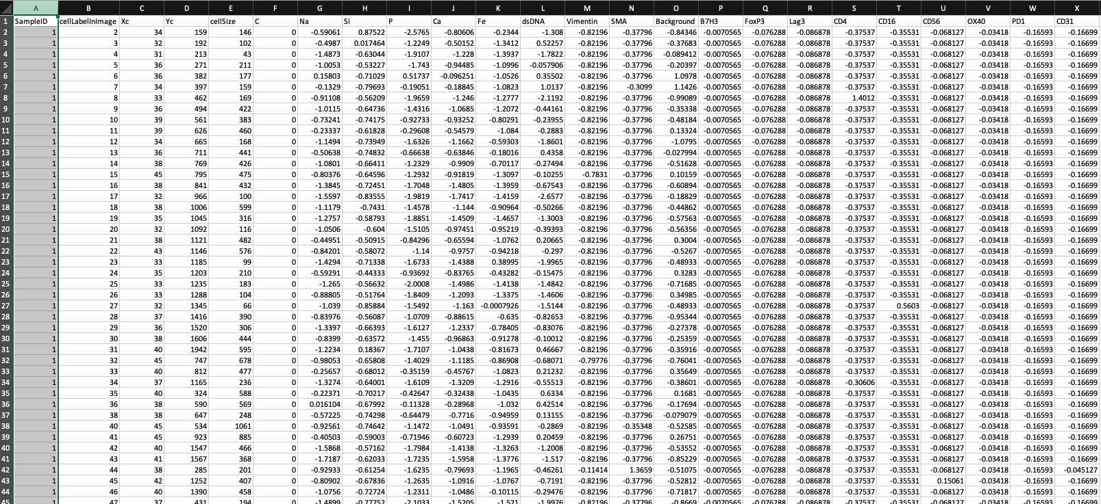
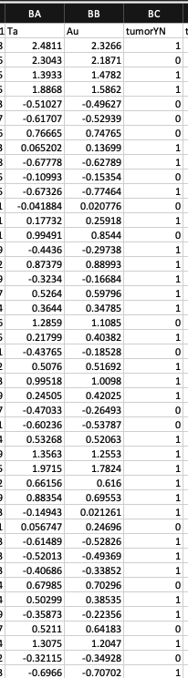
TNBC data

Slide 9
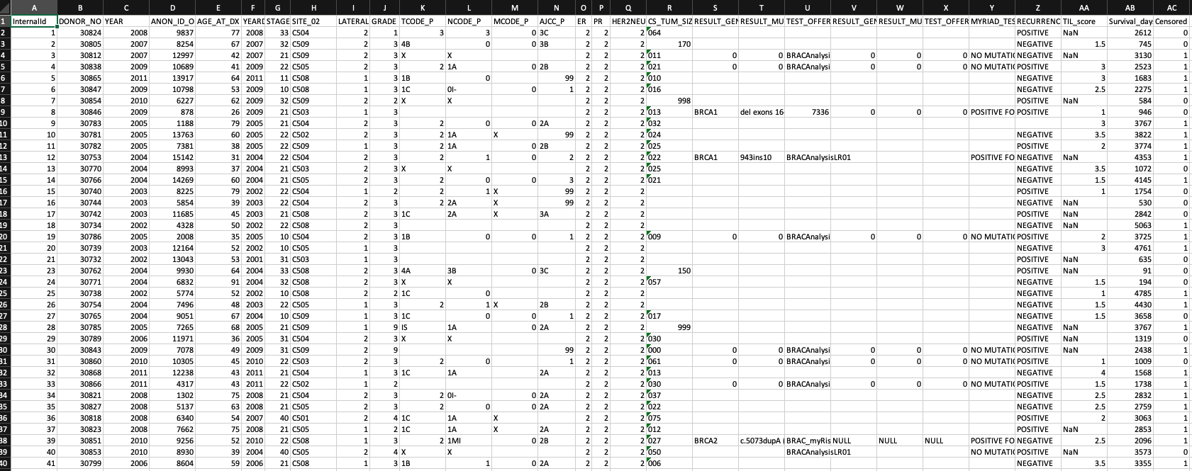
TNBC data

Slide 10
Read and format the image
Nomenclature of phenotypes
Example:
markers: SOX10, CD3, CD4, CD8, CD20
Cell_1: SOX10
Cell_2: CD3,CD4
Cell_3: CD3,CD8
Cell_4: SOX10,CD20
format_image_to_spe()
format = “general”
Preformatting the data and extracting:
Intensities
Phenotypes (can be NA)
Coordinates
Intensities can be matrix/data frame. Note the orientation!
Note:
1. markers on/off
2. Strict syntax – comma, no space
3. The order of the markers!
 | Cell 1 | Cell 2 | …
Marker 1
Marker 2
…
Notes:
Now we come to the most complicated part of the package, formatting the data
Recommend using the “general” format,
Although there are options for HALO, inForm and CODEX.

Slide 11
Predict phenotypes
If the data doesn’t come with phenotypes
predict_phenotypes(spe_object,
thresholds = NULL,
tumour_marker = “SOX10”,
baseline_markers = c(“CD3”, “CD4”, “CD8”,”CD20”),
nuclear_marker = NULL,
reference_phenotypes = FALSE,
markers_to_phenotype = NULL,
plot_distribution = TRUE)
The returned SPE object will have a new column $Phenotype
Following the same nomenclature
Plot the density with threshold by `plot_distribution=TRUE`

Slide 12
Inspect the SPE object
Access phenotype as a column (with $)
unique(spe$Phenotype)
Access marker intensities with the helper function 'assay'
assay(spe)
What is the dimension of the intensity matrix of this object?
dim(assay(spe))
Access coordinates with the helper function 'spatialCoords'
spatialCoords(spe)

Slide 13
Define cell types
Cell types are defined based on phenotypes
Example:
Tumor cells: SOX10
Cytotoxic T cells: CD3,CD8
Follow the nomenclature
The order of the markers
Several combinations of markers can define the same cell type
CD68 => macrophages
CD68,PDL1 => macrophages

Slide 14
Formatting data workflow
Read in the file (.csv, .txt, …)
Preformat the data (marker intensities, phenotypes, coordinates)
format_image_to_spe() to get the SPE object
predict_phenotypes() if there is no phenotype info
define_celltypes() based on phenotypes
Then:
Visualisation and QC

Slide 15
10 min break ☺
Relationships between cells
Cell colosaliastion
Marker coexpression
Immune infiltration
Microenvironment

Slide 16
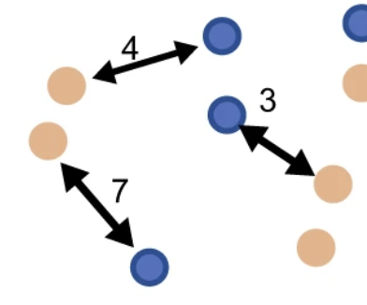
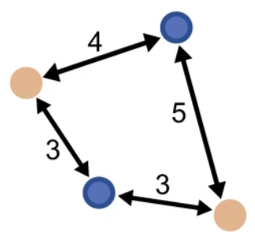
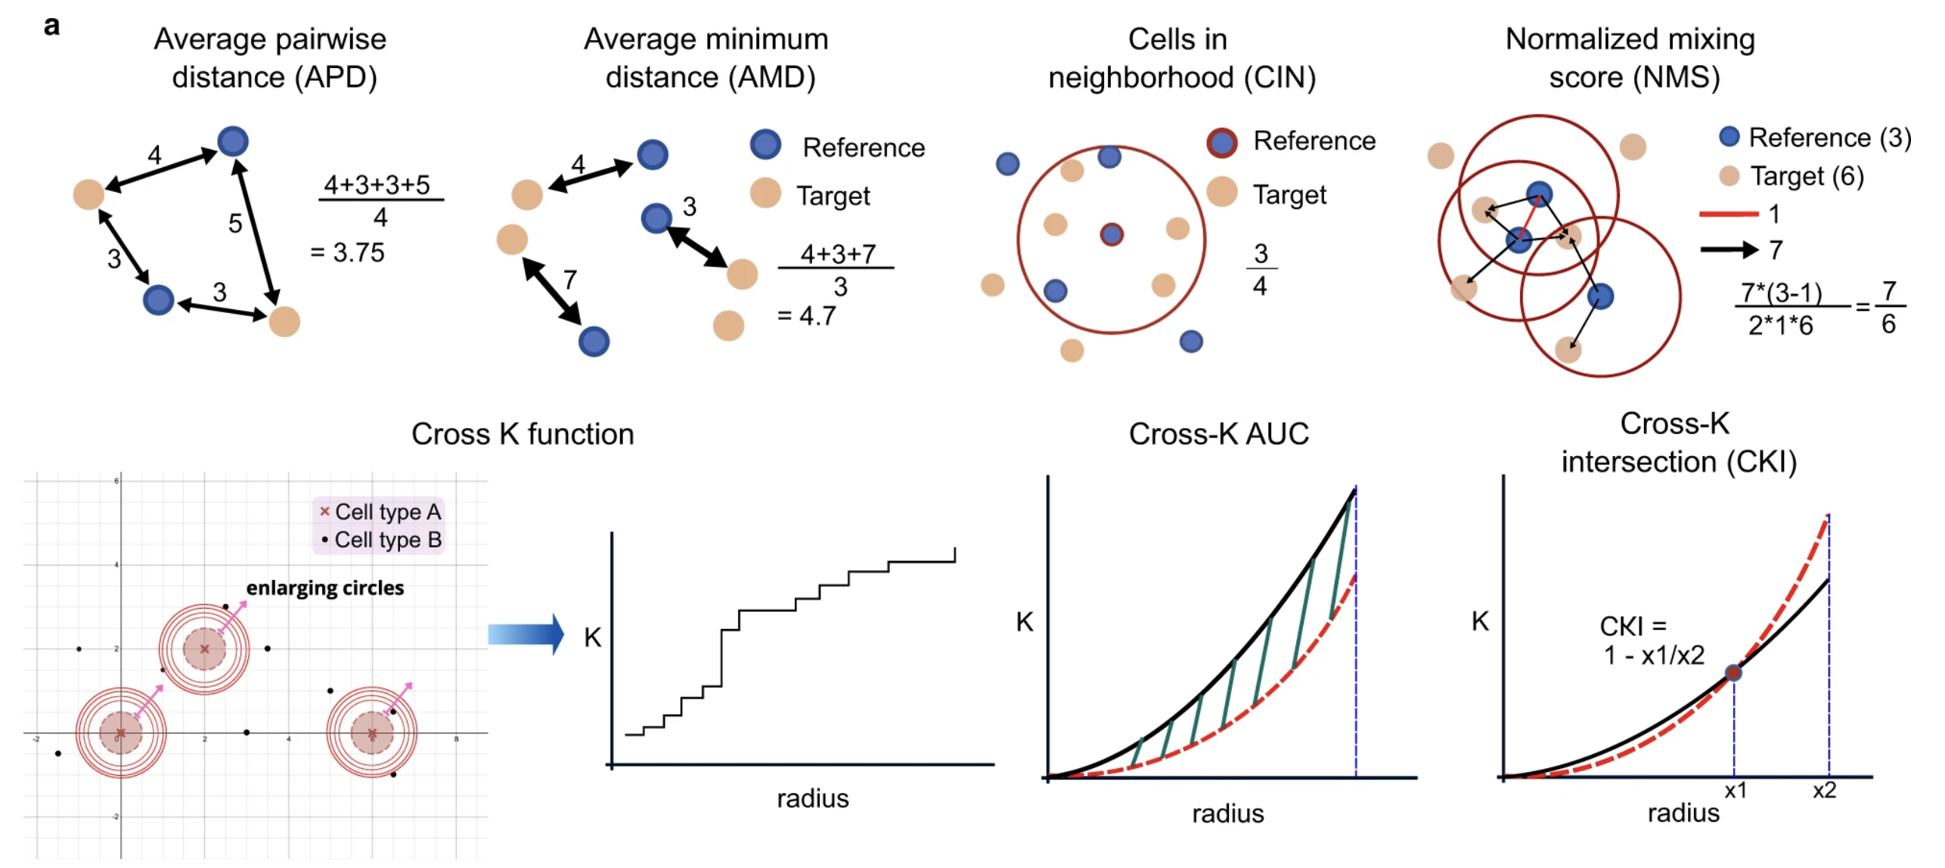
Basic analyses
Cell proportions
Minimum distance
Pairwise distance

Slide 17
Cell colocalisation

Slide 18
Mixing score
$mixing score= \frac{no. of reference to target cell interactions}{no. of reference to reference cell interactions}$
a
b
“Mixing score”: 1/2
“Mixing score”: 3/2
A
B
Keren, L., Bosse, M., Marquez, D., Angoshtari, R., Jain, S., Varma, S., Yang, S. R., Kurian, A., Van Valen, D., West, R., Bendall, S. C., & Angelo, M. (2018). A Structured Tumor-Immune Microenvironment in Triple Negative Breast Cancer Revealed by Multiplexed Ion Beam Imaging. Cell, 174(6), 1373–1387.e19. https://doi.org/10.1016/j.cell.2018.08.039

Slide 19
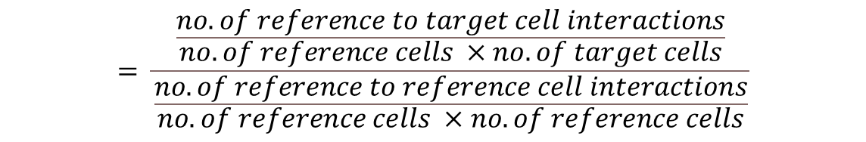
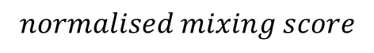
Normalised Mixing score
$$normalised mixing score$$
$$= \frac{\frac{no. of reference to target cell interactions}{no. of reference cells ×no. of target cells}}{\frac{no. of reference to reference cell interactions}{no. of reference cells ×no. of reference cells}}$$
$$= \frac{ref to target cell interactions}{ref to ref cell interactions} × \frac{no. of ref cells}{no. of target cells}$$
Notes:
However, the number of the total interactions in the image will largely affect the calculation of mixing score. To account for this factor, we developed this normalised mixing score to better capture the mixing behaviour of cells regardless of the proportion of different types of cells in the image.

Slide 20
Cross K function

Slide 21
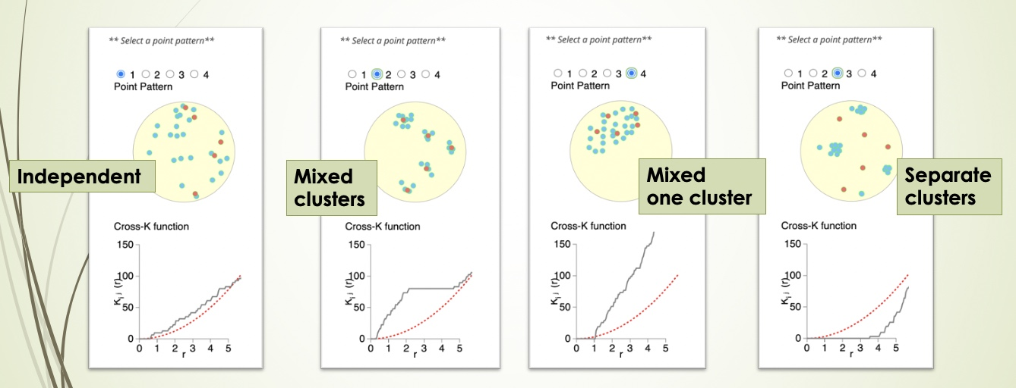
Cross K function

Slide 22
Choosing the radius/radii
It can be arbitrary to choose a distance as the radius
It depends on your biological question
How do you define an interaction– 20 microns? 100 microns?
For metrics with a range of radii (like cross K)
We suggest choosing the radii based on the size of the image

Slide 23
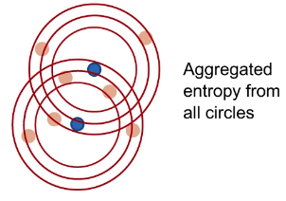
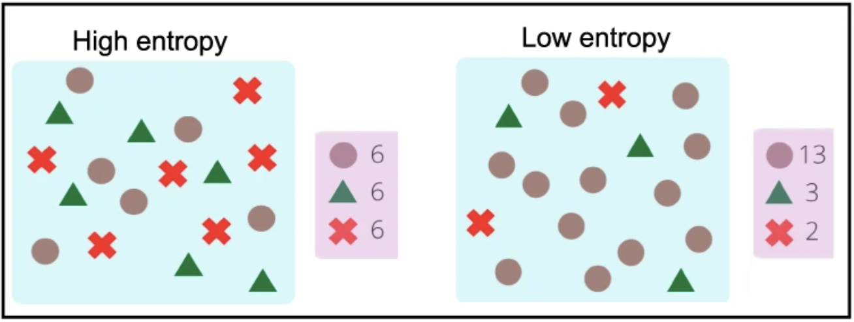
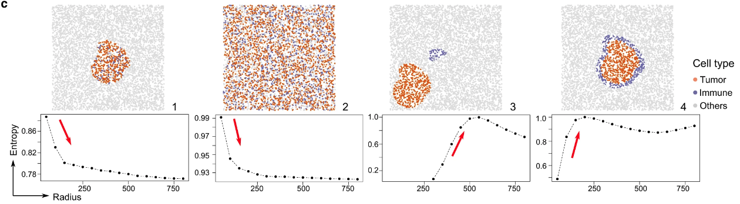
Aggregated entropy gradients

Slide 24
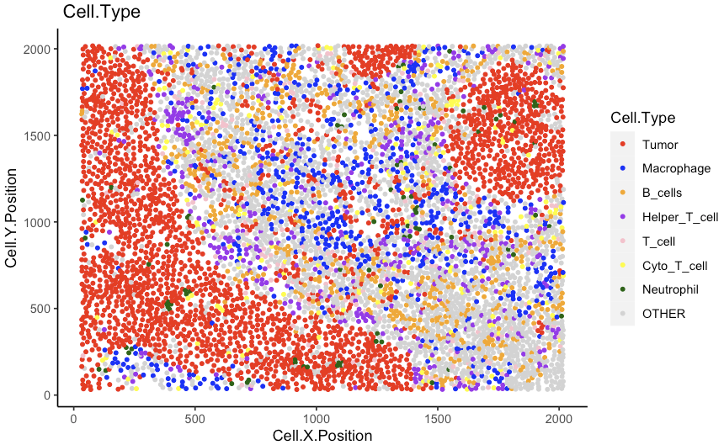
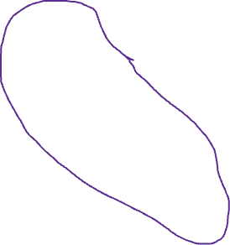
Spatial heterogeneity
Rationale: one image not only has one pattern

Slide 25
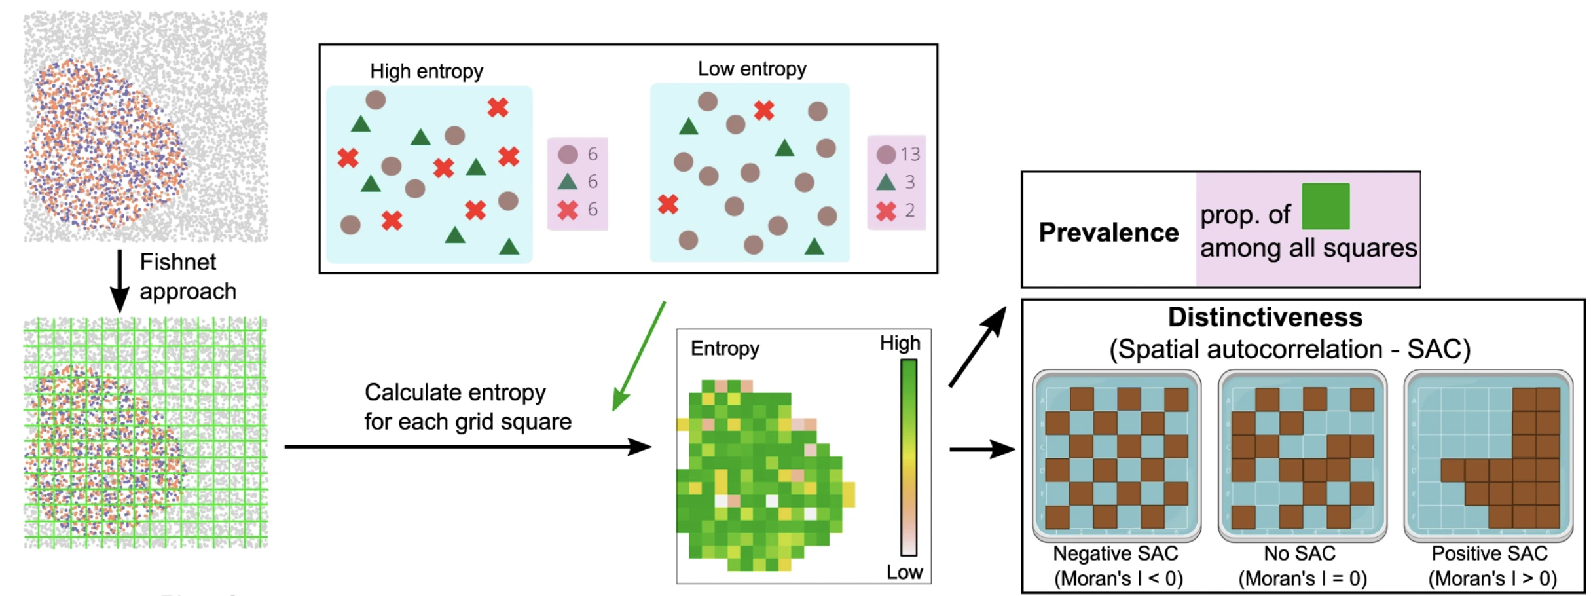
Spatial heterogeneity – grid entropy
grid_metrics(spe_object, FUN = calculate_entropy, n_split = 20,
cell_types_of_interest=your_cell_types,
feature_colname = "Cell.Type")

Slide 26
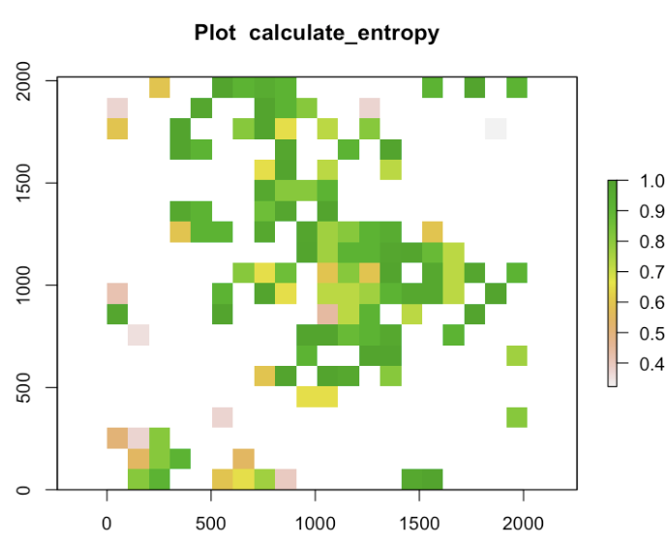
Spatial heterogeneity – grid entropy
calculate_percentage_of_grids(grid, threshold = 0.75, above = TRUE)
Entropy ≈ 0.72 when two cell types ratio = 1:4 or 4:1

Slide 27
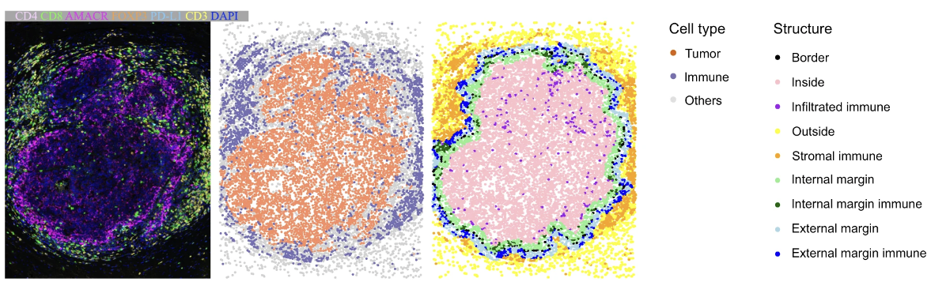
Tissue structure

Slide 28
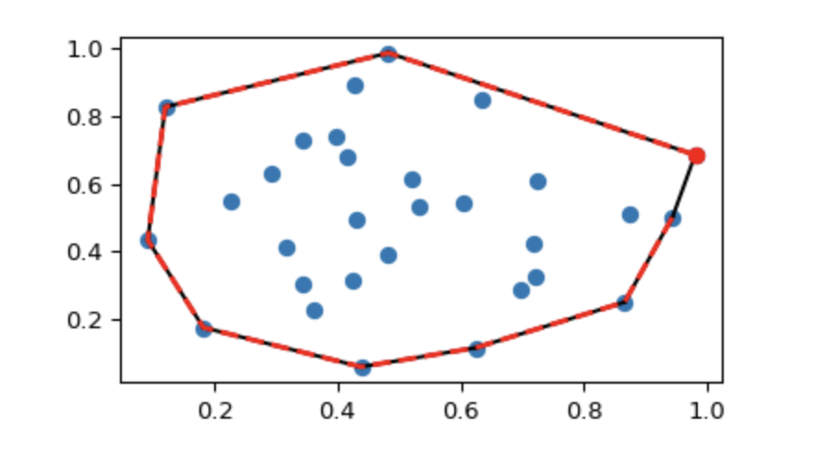
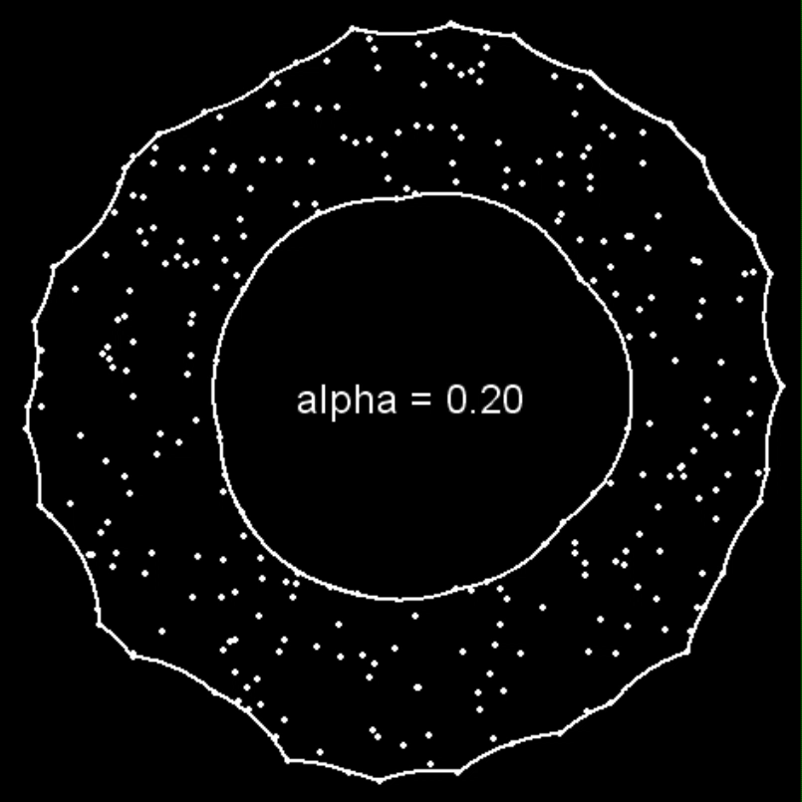
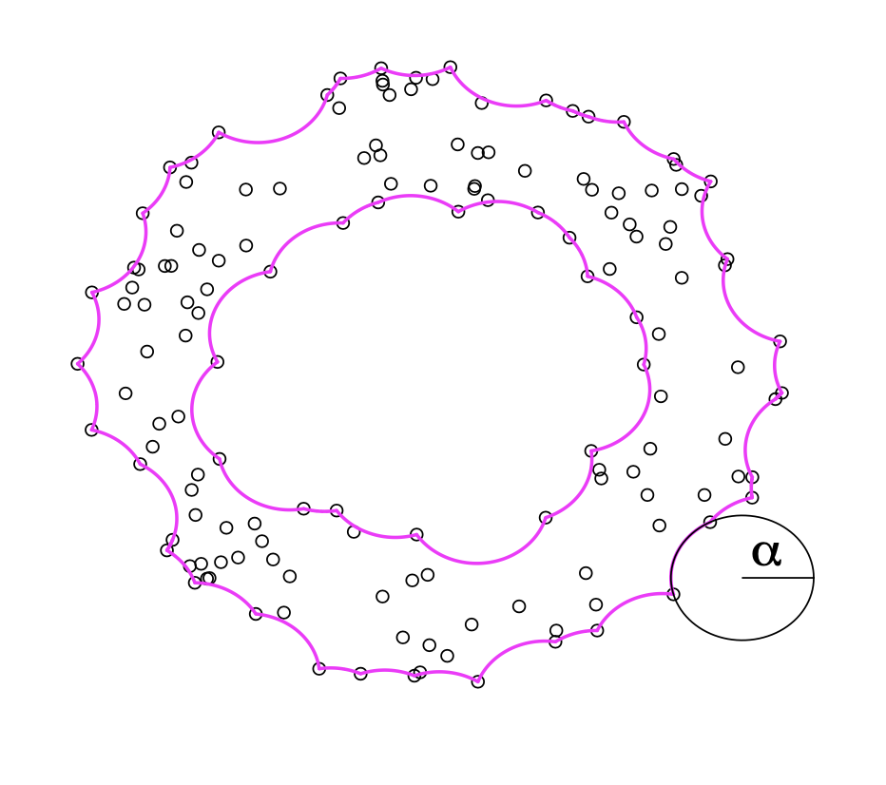
Detect bordering cells - alpha hull
Convex hull
https://www.r-bloggers.com/2010/04/alphahull-an-r-package-for-alpha-convex-hull/
Pateiro-López, Beatriz & Casal, Alberto. (2010). Generalizing the Convex Hull of a Sample: The R Package alphahull. Journal of Statistical Software. 34. 1-28. 10.18637/jss.v034.i05.
Notes:
how does the algorithm work? Here we used alpha hull, which is similar to a convex hull. What is a convex hull? Here are some points. Image you use a rubber band to wrap up all the points. You stretch and snap shut. The shape that the rubber band forms is the convex hull.
The segments between points on the convex hull are straight lines, while for alpha hull, they are curves. The curves are all from a circle of the same radius, alpha. You can see that with alpha changes, the shape of alpha hull also changes.
The alpha hull of the tumour cells give us the margin of the tumour. And the cells on the alpha hull are the bordering cells.
How to find the value of alpha. It depends on the number of cells in the tumour region.

Slide 29
Tissue structure
identify_bordering_cells(spe_object = your_img_object,
reference_cell = ”?",
feature_colname="Cell.Type",
ahull_alpha = NULL,
n_to_exclude = 25,
plot_final_border = TRUE)
The alpha value is automatically calculated
when ahull_alpha = NULL;
You can change it. The larger the alpha, the
less defined the bordering cells are.

Slide 30
What if no clear tumour regions
Ratio of bordering cells to tumour cells
Average nearest neighbor (ANN) index

Slide 31
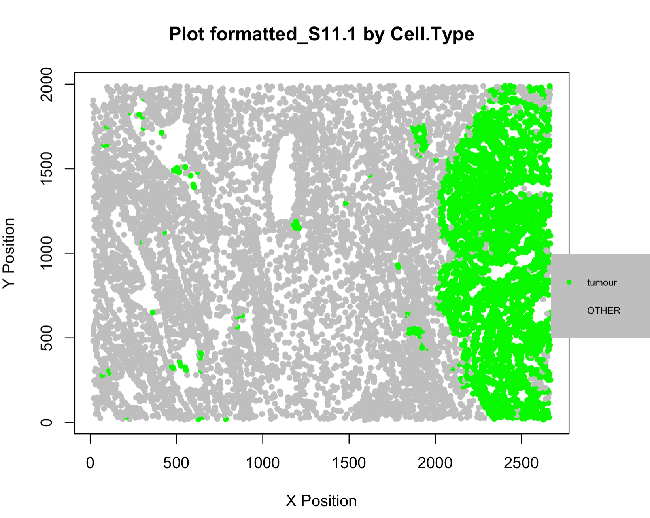
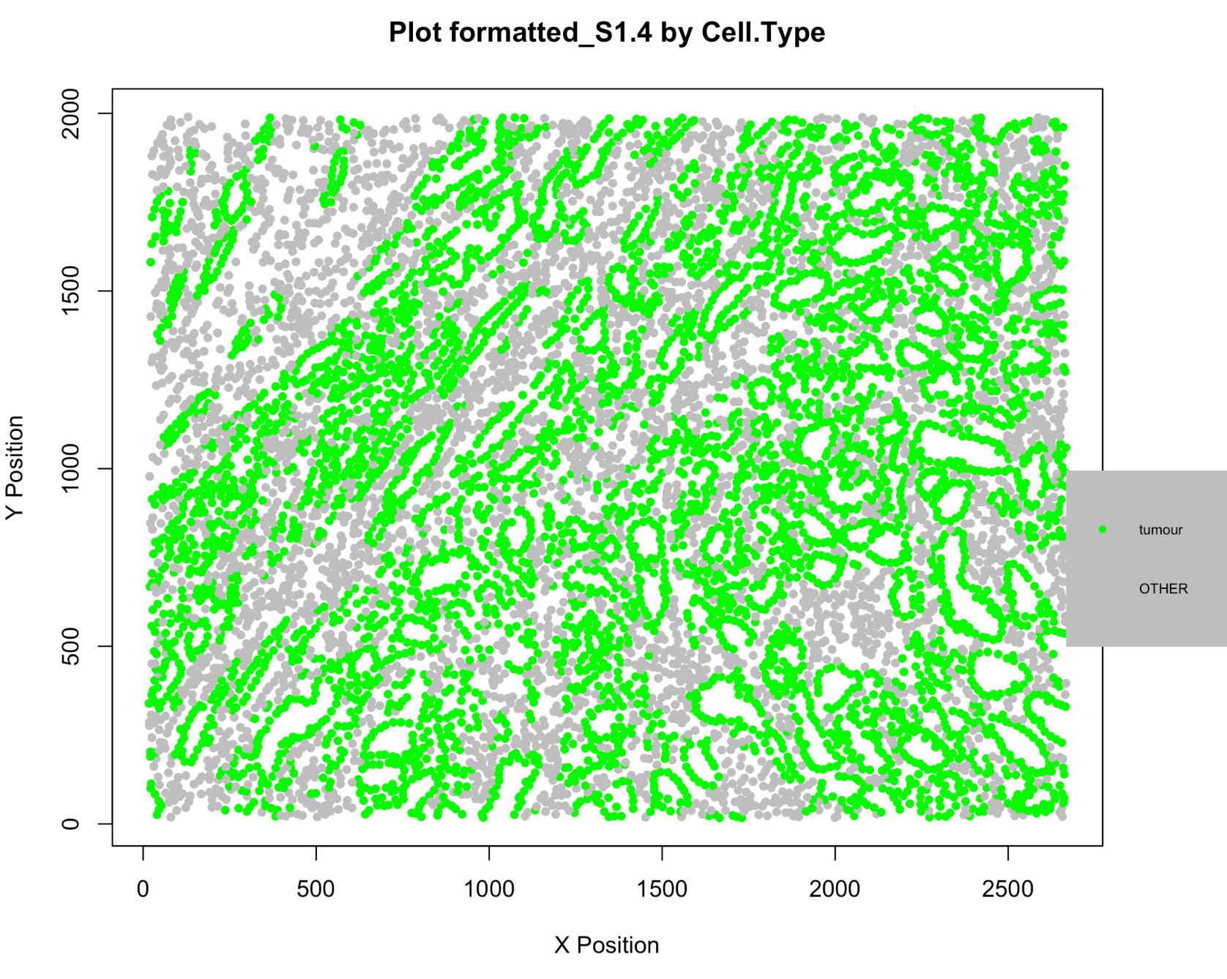
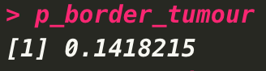
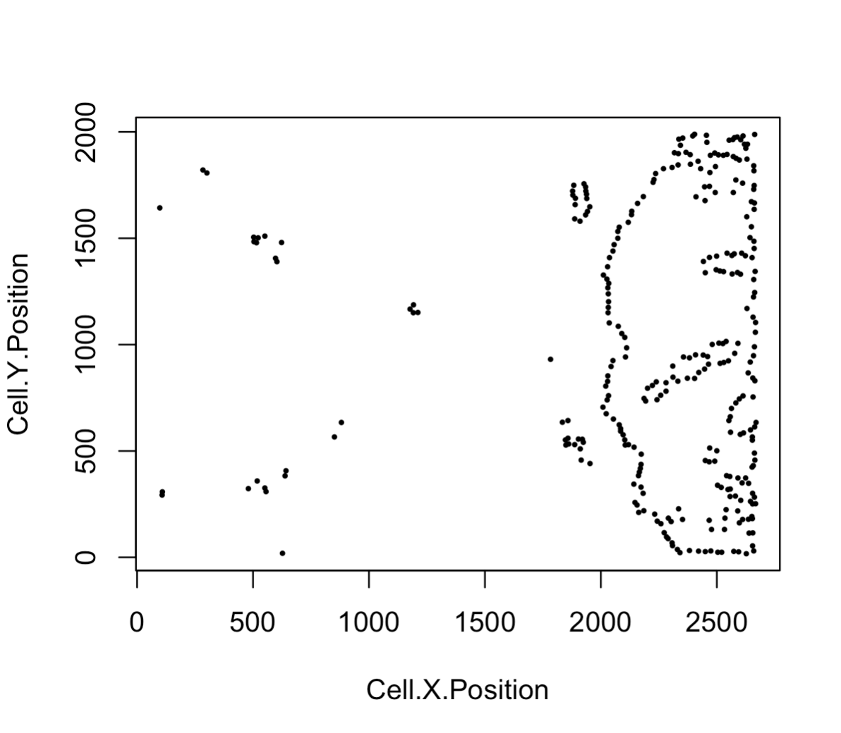
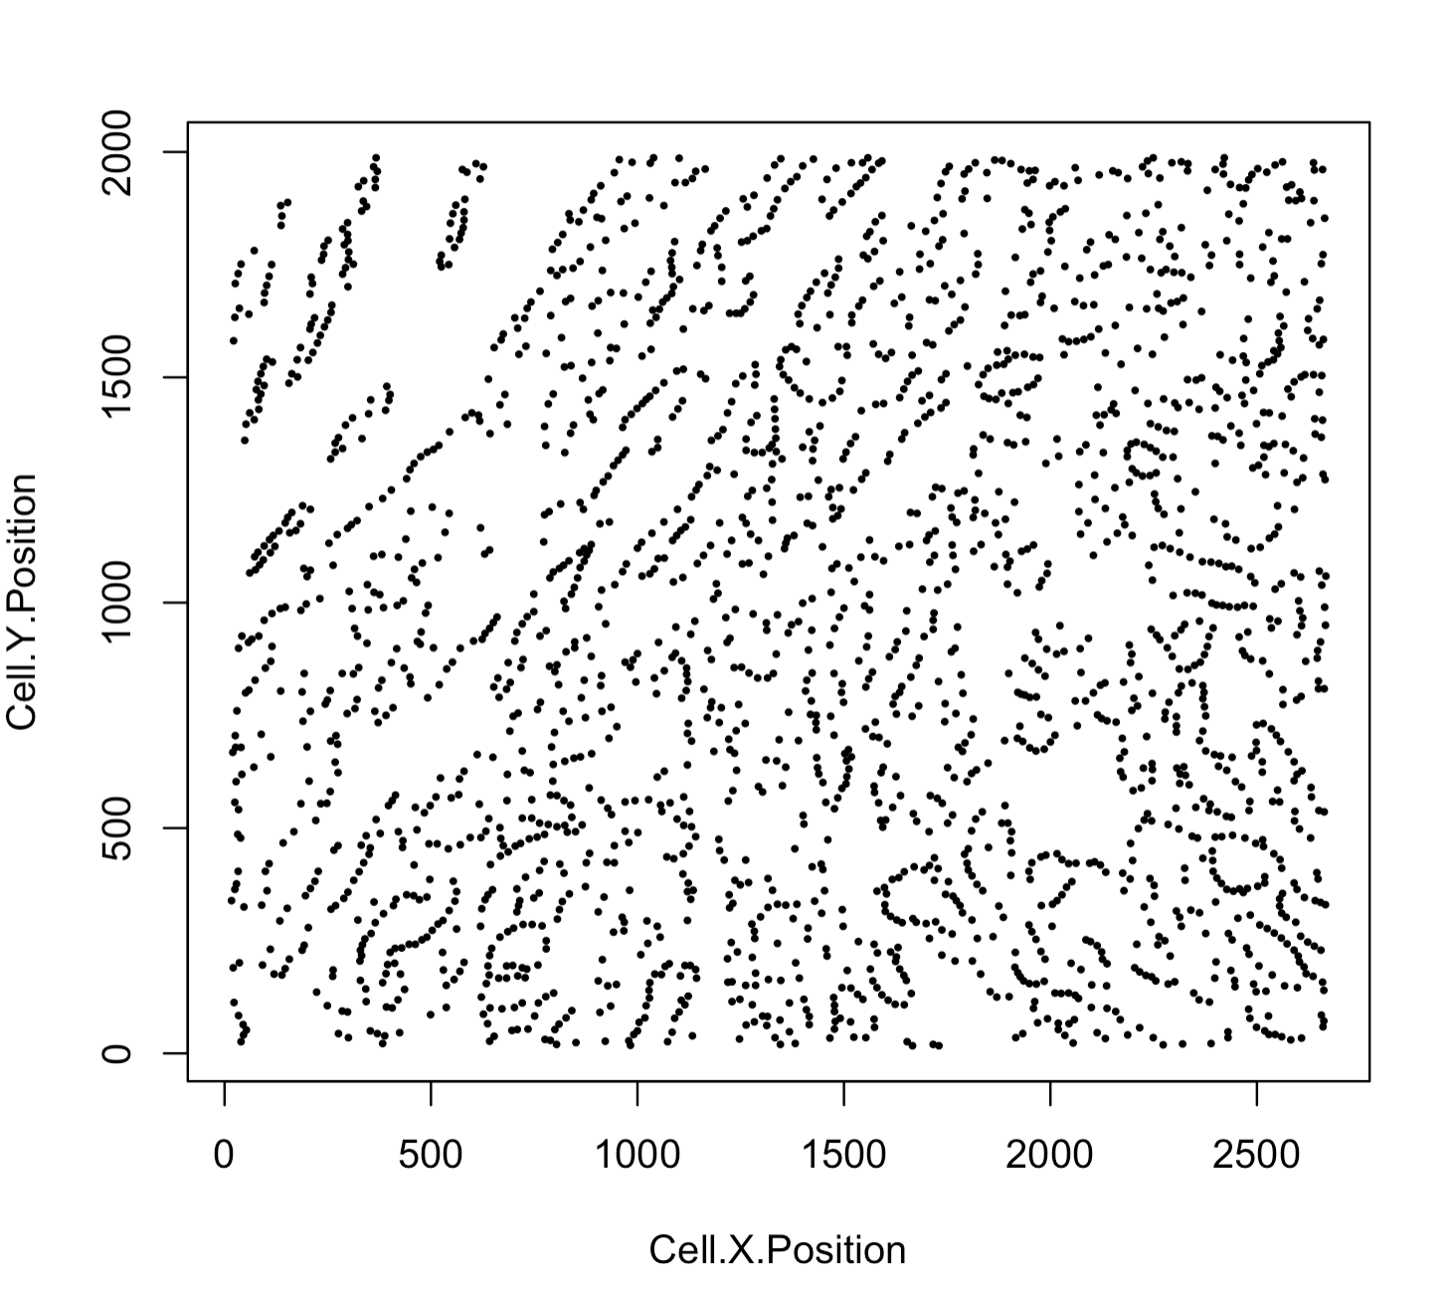
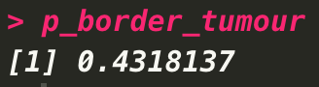
Ratio of bordering cells to tumour cells (R-BC)
Notes:
If an image has a clear tumour region, the bordering cells identified will be a small proportion of all the tumour cells.
Compared with the image on the left, the bordering cells identified in the image on the right are almost all of the tumour cells.
A low bordering tumour cell proportion indicates an image with clear tumour region and vice versa.

Slide 32
Tissue structure
formatted_distance <- calculate_distance_to_margin(spe_object = your_img_object_with_border_cells)
formatted_structure <- define_structure(spe_object = your_img_object_with_distance_calculated,
cell_types_of_interest = names_of_immune_cells,
feature_colname = "Cell.Type",
n_margin_layers = 5,
margin_dist = NULL)
Choose one of the arguments to use, either
the number of cell layers or the distance to
Margin (microns)

Slide 33
Challenge
We have 39 patient information in the TNBC dataset.
Try applying the spatial metrics and associating with the clinical data.

Slide 34
TNBC data

Slide 35
TNBC data

Slide 36
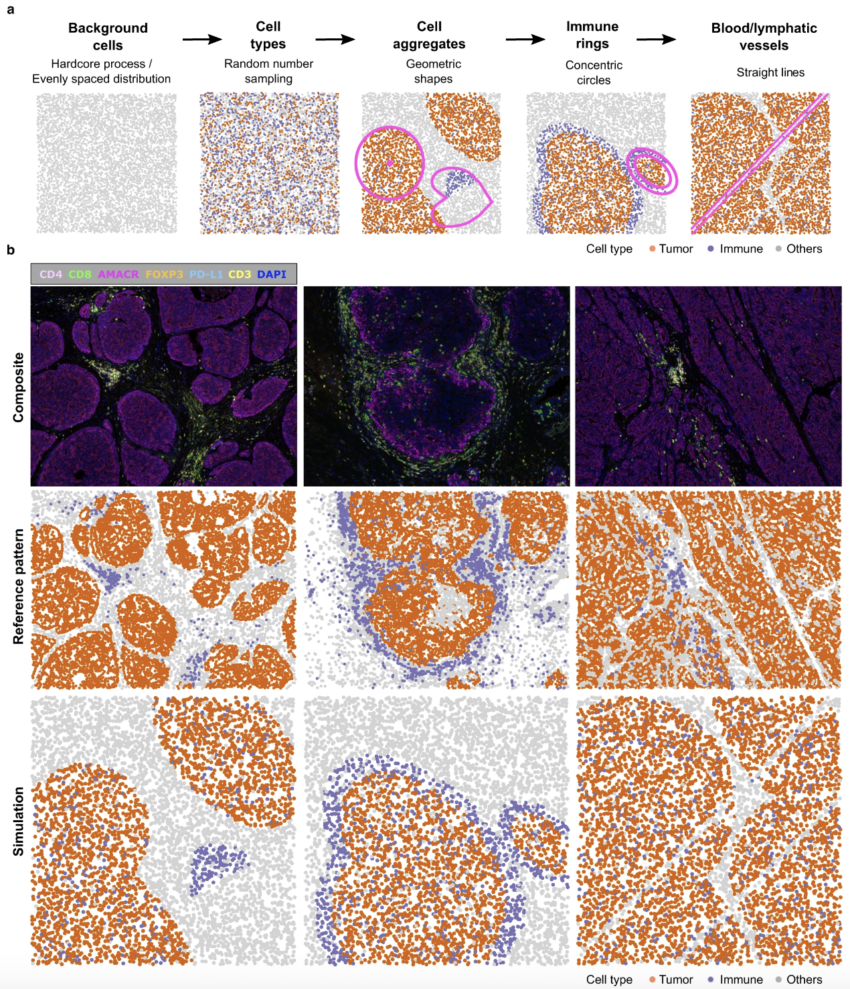
spaSim – spatial Simulator
Simulate the cell locations in 2D
Can simulate cell types
and tissue structures
but can’t simulate marker intensities

Slide 37
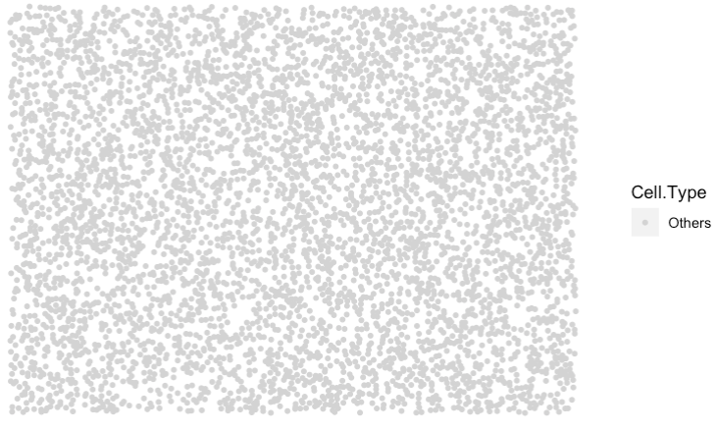
Simulate background cells
# simulate background cells
set.seed(610)
bg <- simulate_background_cells(n_cells = 5000,
width = 2000,
height = 2000,
method = "Hardcore",
min_d = 10,
oversampling_rate = 1.6,
Cell.Type = "Others")

